Slide 1
Enhancing Emotional Intelligence

Slide 2
1. Don't interrupt or change the subject.

Slide 3
If feelings are uncomfortable, we may want to avoid them by interrupting or distracting ourselves.
Sit down at least twice a day and ask, "How am I feeling?"
It may take a little time for the feelings to arise.
Allow yourself that small space of time, uninterrupted.

Slide 4

2. Don't judge or edit feelings too quickly.

Slide 5
Try not to dismiss your feelings before you have a chance to think them through.
Healthy emotions often rise and fall in a wave, rising, peaking, and fading naturally.
Your aim should be not to cut off the wave before it peaks.

Slide 6
3. See if you can find connections

Slide 7
See if you can find connections between your feelings and other times you have felt the same way.
When a difficult feeling arises, ask yourself, "When have I felt this feeling before?"
Doing this may help you to realize if your current emotional state is reflective of the current situation, or of another time in your past.

Slide 8
4. Connect your feelings with your thoughts.

Slide 9

When you feel something that strikes you as out of the ordinary, it is always useful to ask, "What do I think about that?"
Often times, one of our feelings will contradict others. That's normal.

Slide 10

Listening to your feelings is like listening to all the witnesses in a court case.
Only by admitting all the evidence will you be able to reach the best verdict.

Slide 11

5. Listen to your body.

Slide 12


A knot in your stomach while driving to work may be a clue that your job is a source of stress.

Slide 13

A flutter of the heart when you pick up a girl you have just started to date may be a clue that this could be "the real thing."

Slide 14
Listening to these sensations and the underlying feelings that they signal will allow you to process with your powers of reason.

Slide 15
6. If you don't know how you're feeling, ask someone else.

Slide 16
`
People rarely realize that others are able to judge how they are feeling.
Ask someone who knows you (and whom you trust) how you are coming across.
You may find the answer both surprising and informative

Slide 17
7. Tune in to your unconscious feelings.

Slide 18
How can you become more aware of your unconscious feelings?
Try free association.
While in a relaxed state, allow your thoughts to roam freely and watch where they go.

Slide 19
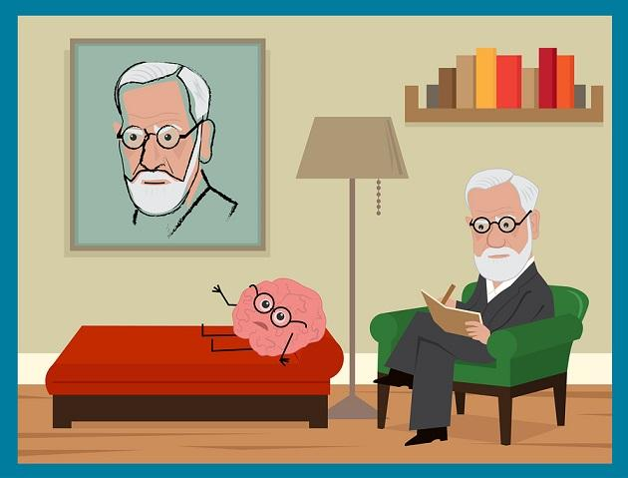
Free association is a practice in psychoanalytic therapy. In this practice, a therapist asks a person in therapy to freely share thoughts, words, and anything else that comes to mind.

Slide 20
Analyze your dreams.
Keep a notebook and pen at the side of your bed and jot down your dreams as soon as you wake up.
Pay special attention to dreams that repeat or are charged with powerful emotion.

Slide 21
8. Ask yourself: How do I feel today?

Slide 22
Start by rating your overall sense of well-being on a scale of 0 and 10 and write the scores down in a daily log book.
If your feelings seem extreme one day, take a minute or two to think about any ideas or associations that seem to be connected with the feeling.

Slide 23
9. Write thoughts and feelings down.

Slide 24
Research has shown that writing down your thoughts and feelings can help intensely.
A simple exercise like this could take only a few hours per week.

Slide 25
10. Know when enough is enough.

Slide 26
There comes a time to stop looking inward; learn when its time to shift your focus outward.
Emotional intelligence involves not only the ability to look within, but also to be present in the world around you.
Notes:
Studies have shown that encouraging people to settle upon negative feelings can amplify these feelings.

Slide 27
11.Pay Attention to How You Behave

Slide 28
Notice how you act when you’re experiencing certain emotions, and how that affects your day-to-day life.
Does it impact your communication with others, your productivity, or your overall sense of well-being?
Once we become more conscious of how we’re reacting to our emotions, it’s easy to slip into judgement mode and start attaching labels to our behavior.
Try to refrain from doing that right now, as you’ll be far more likely to be honest with yourself if you’re not judging yourself at the same time.

Slide 29
12. Take Responsibility for Your Feelings and Behavior

Slide 30
This is probably the most challenging step, and it’s also the most helpful.
Your emotions and behavior come from you—they don’t come from anyone else—therefore, you’re the one who’s responsible for them.
Your Reaction Is Your Responsibility.

Slide 31
Equally, your feelings can provide you with valuable information about your experience of the other person, as well as your own needs and preferences, but your feelings aren’t another person’s responsibility.
Once you start accepting responsibility for how you feel and how you behave, this will have a positive impact on all areas of your life.

Slide 32
13.Practice Responding, Rather than Reacting

Slide 33
Reacting is an unconscious process where we experience an emotional trigger, and behave in an unconscious way that expresses or relieves that emotion (for example, feeling irritated and shouting at the person who has just interrupted you).
Responding is a conscious process that involves noticing how you feel, then deciding how you want to behave (for example, feeling irritated, explaining to the person how you feel, why this isn’t a good time to be interrupting you, and when would be better).

Slide 34
14.Practice Empathizing with Yourself and Others

Slide 35
Empathy is about understanding why someone feels or behaves in a certain way and being able to communicate that understanding to them.
It applies to ourselves and other people, and practicing this ability will improve your EI.

Slide 36
Start by practicing with yourself.
When you notice yourself feeling or behaving in a certain way, ask “Why do I think I’m feeling like this/doing this?”
At first, your response might be “I don’t know,” but keep paying attention to your feelings and behavior, and you’ll start to notice different answers coming through.

Slide 37
15.Create A Positive Environment
Creating a positive environment not only improves your quality of life, but it can be contagious to people around you too.

Slide 38
16.Remember EI is a Lifetime Process
EI isn’t something you develop once then drop.
It’s a lifetime practice, and it is possible to keep improving.
Even when you feel like you’ve mastered these steps, remember to keep practicing, and you’ll reap the benefits of EI for the rest of your life.

